Slide 1
โปรแกรมจำลองการทำงานวงจรดิจิตอล
(Digital Circuit Simulator)
อาจารย์ที่ปรึกษา อ. เจริญ วงค์ชุ่มเย็น
นาย กร พวงนาค รหัส 46015333
นาย จิรวุฒิ ยุวเบญจพล รหัส 46015341

Slide 2
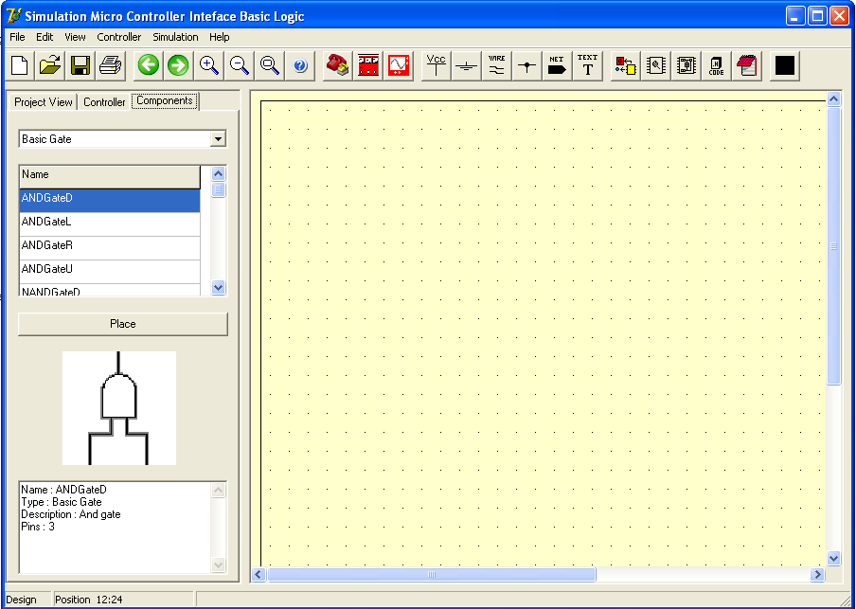
ลักษณะรูปร่างหน้าตาโปรแกรม

Slide 3
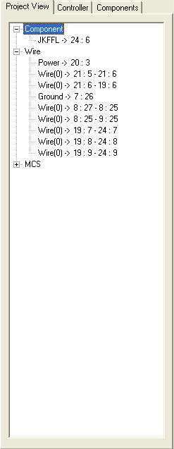
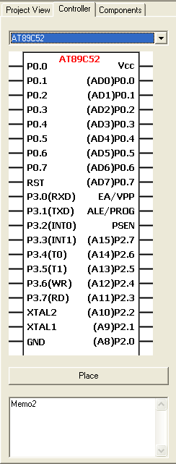
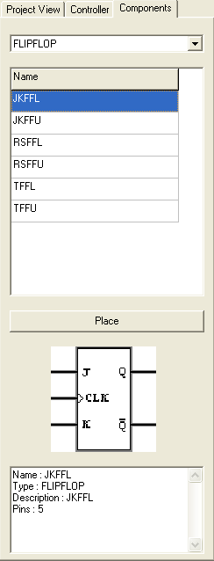
รูปร่างของส่วนเลือกอุปกรณ์

Slide 4
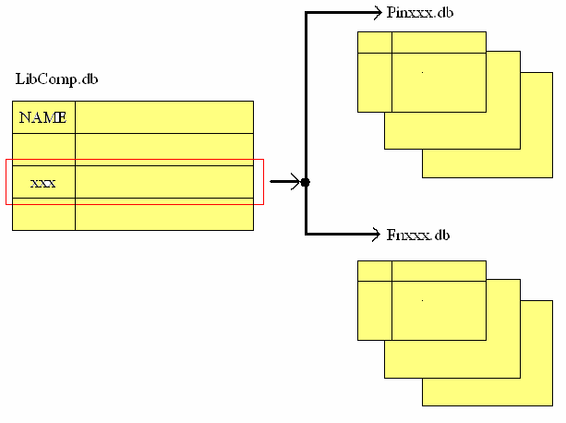
ลักษณะการเก็บ Library ของ Component

Slide 5
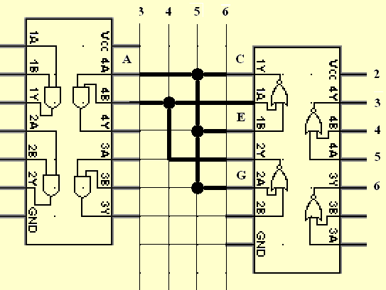
การ Routing เส้นทาง

Slide 6
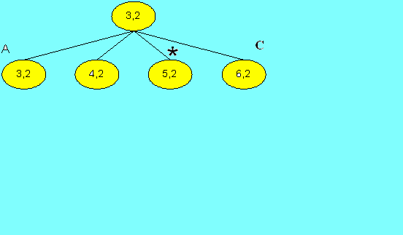
การหาเส้นทาง (ต่อ)

Slide 7
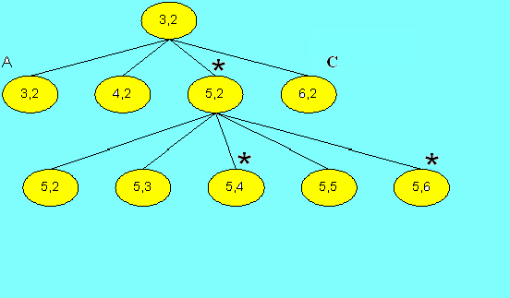
การหาเส้นทาง (ต่อ)

Slide 8
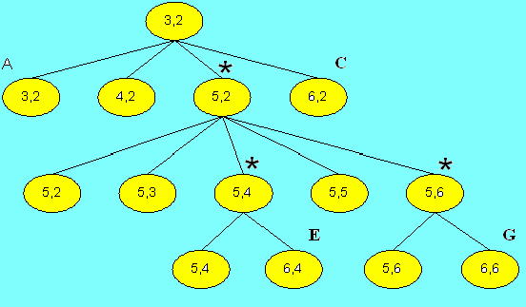
การหาเส้นทาง (ต่อ)

Slide 9
ตารางข้อมูลเส้นทางที่ได้
Serial | Item | Type | Pin name | X,Y
0 | 7408 | IN | A | 3,2
*1 | 7402 | OUT | C | 6,2
1 | 7402 | IN | E | 6,4
1 | 7402 | IN | G | 6,6

Slide 10
ตารางสรุปการเชื่อมต่อ
Serial IN | Item In | Pin In | Serial Out | Item Out | Pin Out
0 | 7408 | A | 1 | 7402 | C
1 | 7402 | E | 1 | 7402 | C
1 | 7402 | G | 1 | 7402 | C

Slide 11
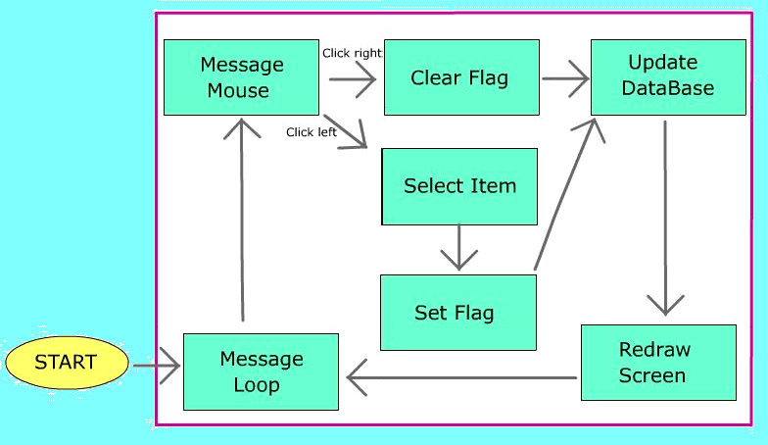
กระบวนการเลือก และ ลงอุปกรณ์

Slide 12
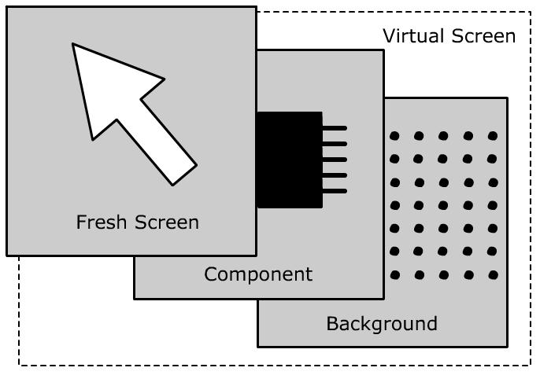
หน้าจอเสมือน สำหรับการ Simulate

Slide 13
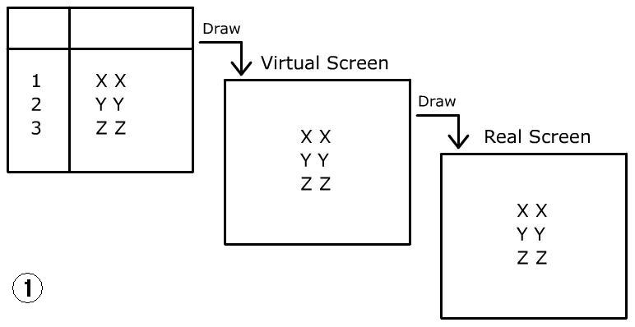
หน้าจอเสมือน (continue)

Slide 14
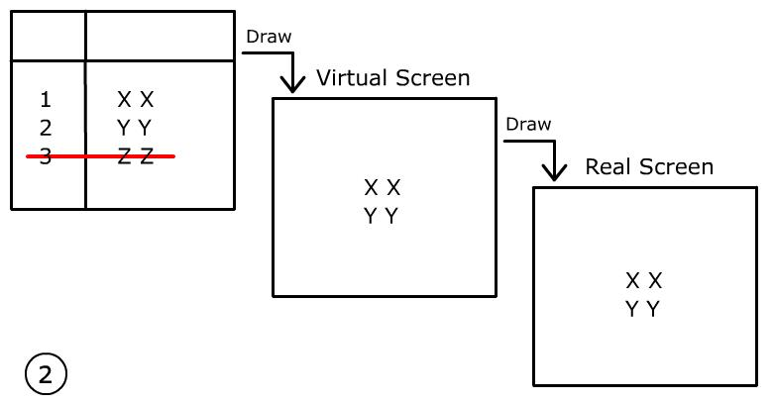
หน้าจอเสมือน (continue)

Slide 15
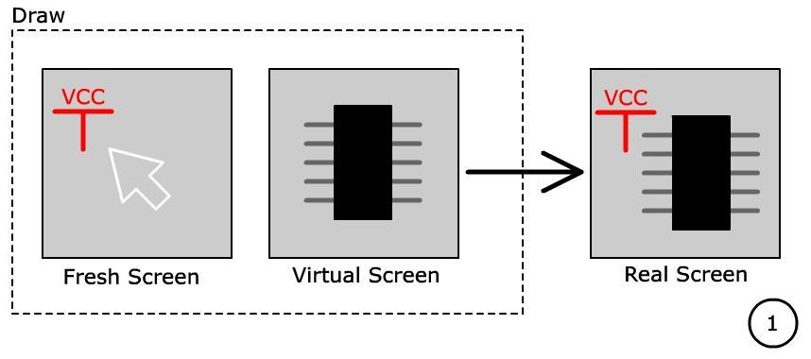
หน้าจอเสมือน (continue)

Slide 16
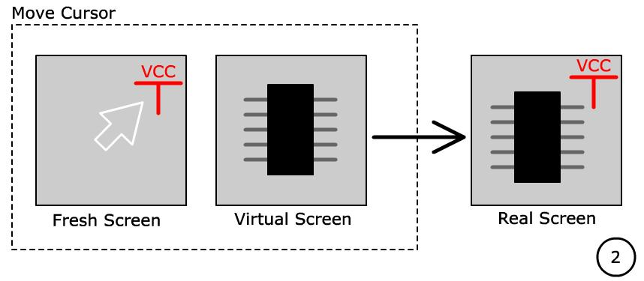
หน้าจอเสมือน (continue)

Slide 17
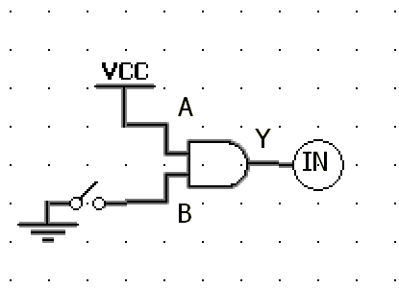
Finding Boolean
Serial IN | Item IN | Pin IN | Serial Out | Item Out | Pin Out

Slide 18
Finding Boolean
Serial IN | Item IN | Pin IN | Serial Out | Item Out | Pin Out
0 | AND | A | - | VCC | 1

Slide 19
Finding Boolean
Serial IN | Item IN | Pin IN | Serial Out | Item Out | Pin Out
0 | AND | A | - | VCC | 1
0 | AND | B | 2 | SW | OUT

Slide 20
Finding Boolean
Serial IN | Item IN | Pin IN | Serial Out | Item Out | Pin Out
0 | AND | A | - | VCC | 1
0 | AND | B | 2 | SW | OUT
1 | LED | IN | 0 | AND | Y

Slide 21
Finding Boolean
Serial IN | Item IN | Pin IN | Serial Out | Item Out | Pin Out
0 | AND | A | - | VCC | 1
0 | AND | B | 2 | SW | OUT
1 | LED | IN | 0 | AND | Y
2 | SW | IN | - | GND | 0

Slide 22
Finding Boolean
Serial IN | Item IN | Pin IN | Serial Out | Item Out | Pin Out
0 | AND | A | - | VCC | 1
0 | AND | B | 2 | SW | OUT
1 | LED | IN | 0 | AND | Y
2 | SW | IN | - | GND | 0

Slide 23
Finding Boolean
Serial IN | Item IN | Pin IN | Serial Out | Item Out | Pin Out
0 | AND | A | - | VCC | 1
0 | AND | B | 2 | SW | OUT
1 | LED | IN | 0 | AND | Y
2 | SW | IN | - | GND | 0
Result Table
Serial | Item | Pin | State

Slide 24
Finding Boolean
Serial IN | Item IN | Pin IN | Serial Out | Item Out | Pin Out
0 | AND | A | - | VCC | 1
0 | AND | B | 2 | SW | OUT
1 | LED | IN | 0 | AND | Y
2 | SW | IN | - | GND | 0
Serial | Item | Pin | State
0 | AND | A | 1

Slide 25
Finding Boolean
Serial IN | Item IN | Pin IN | Serial Out | Item Out | Pin Out
0 | AND | A | - | VCC | 1
0 | AND | B | 2 | SW | OUT
1 | LED | IN | 0 | AND | Y
2 | SW | IN | - | GND | 0
Serial | Item | Pin | State
0 | AND | A | 1
2 | SW | IN | 0

Slide 26
Finding Boolean
Serial IN | Item IN | Pin IN | Serial Out | Item Out | Pin Out
0 | AND | A | - | VCC | 1
0 | AND | B | 2 | SW | OUT
1 | LED | IN | 0 | AND | Y
2 | SW | IN | - | GND | 0
Serial | Item | Pin | State
0 | AND | A | 1
2 | SW | IN | 0

Slide 27
Finding Boolean
Serial IN | Item IN | Pin IN | Serial Out | Item Out | Pin Out
0 | AND | A | - | VCC | 1
0 | AND | B | 2 | SW | OUT
1 | LED | IN | 0 | AND | Y
2 | SW | IN | - | GND | 0
Serial | Item | Pin | State
0 | AND | A | 1
2 | SW | IN | 0
Relation Table
Serial IN | Item IN | Pin IN | Serial Out | Item Out | Pin Out

Slide 28
Finding Boolean
Serial IN | Item IN | Pin IN | Serial Out | Item Out | Pin Out
0 | AND | A | - | VCC | 1
0 | AND | B | 2 | SW | OUT
1 | LED | IN | 0 | AND | Y
2 | SW | IN | - | GND | 0
Serial | Item | Pin | State
0 | AND | A | 1
2 | SW | IN | 0
Relation Table
Serial IN | Item IN | Pin IN | Serial Out | Item Out | Pin Out
0 | AND | B | 2 | SW | OUT

Slide 29
Finding Boolean
Serial IN | Item IN | Pin IN | Serial Out | Item Out | Pin Out
0 | AND | A | - | VCC | 1
0 | AND | B | 2 | SW | OUT
1 | LED | IN | 0 | AND | Y
2 | SW | IN | - | GND | 0
Serial | Item | Pin | State
0 | AND | A | 1
2 | SW | IN | 0
Relation Table
Serial IN | Item IN | Pin IN | Serial Out | Item Out | Pin Out
0 | AND | B | 2 | SW | OUT
1 | LED | IN | 0 | AND | Y

Slide 30
Finding Boolean
Serial IN | Item IN | Pin IN | Serial Out | Item Out | Pin Out
0 | AND | A | - | VCC | 1
0 | AND | B | 2 | SW | OUT
1 | LED | IN | 0 | AND | Y
2 | SW | IN | - | GND | 0
Serial | Item | Pin | State
0 | AND | A | 1
2 | SW | IN | 0
Relation Table
Serial IN | Item IN | Pin IN | Serial Out | Item Out | Pin Out
0 | AND | B | 2 | SW | OUT
1 | LED | IN | 0 | AND | Y

Slide 31
Finding Boolean
Relation Table
Serial IN | Item IN | Pin IN | Serial Out | Item Out | Pin Out
0 | AND | B | 2 | SW | OUT
1 | LED | IN | 0 | AND | Y
Result Table
Serial | Item | Pin | State
0 | AND | A | 1
2 | SW | IN | 0
Function Table

Slide 32
Finding Boolean
Relation Table
Serial IN | Item IN | Pin IN | Serial Out | Item Out | Pin Out
0 | AND | B | 2 | SW | OUT
1 | LED | IN | 0 | AND | Y
Result Table
Serial | Item | Pin | State
0 | AND | A | 1
2 | SW | IN | 0
0 | AND | B | 1
Function Table

Slide 33
Finding Boolean
Relation Table
Serial IN | Item IN | Pin IN | Serial Out | Item Out | Pin Out
1 | LED | IN | 0 | AND | Y
Result Table
Serial | Item | Pin | State
0 | AND | A | 1
2 | SW | IN | 0
0 | AND | B | 1
1 | LED | IN | 1
Function Table

Slide 34
Finding Boolean
Relation Table
Serial IN | Item IN | Pin IN | Serial Out | Item Out | Pin Out
Result Table
Serial | Item | Pin | State
0 | AND | A | 1
2 | SW | IN | 0
0 | AND | B | 1
1 | LED | IN | 1

Slide 35
Finding Boolean
Result Table
Serial | Item | Pin | State
0 | AND | A | 1
2 | SW | IN | 0
0 | AND | B | 1
1 | LED | IN | 1

Slide 36
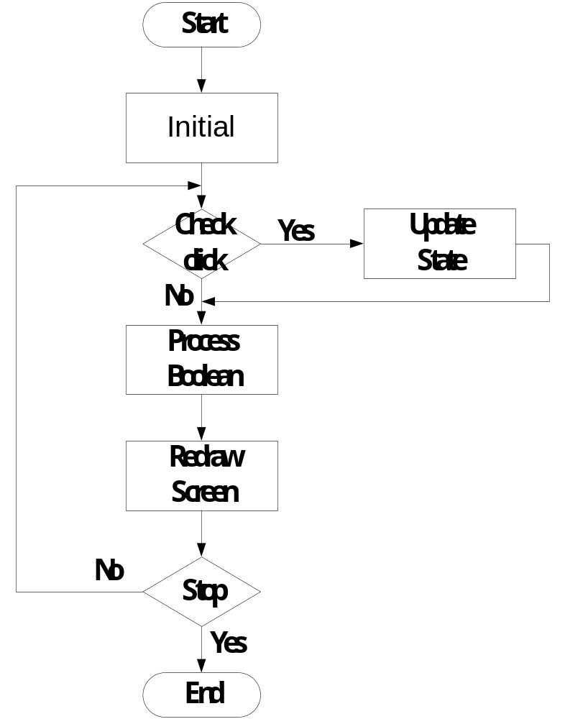
Finding Boolean
Flow Chart

Slide 37
Redraw Runtime
Background

Slide 38
Redraw Runtime
Component No Action
Background

Slide 39
Redraw Runtime
Component Action
Component No Action
Background

Slide 40
Redraw Runtime
Animation
Buffer

